Slide 1
MID-TERM EXAM
CHAPTERS: 1, 2, 3, 9, 10
90 minutes, written test
All multiple choice questions

Slide 2
Chapter 1
1. Definition of critical thinking
2. Eight standards of critical thinking
3. Five barriers to critical thinking

Slide 3
Review of Chapter 1
Critical thinking means skilled judgment or observation by clear intellectual standards
Eight standards of critical thinking
Barriers to critical thinking
Clarity
Accuracy
Precision
Relevance
Consistency
Logical correctness
Completeness
Fairness
Egocentrism
Sociocentrism
Unwarranted assumption
Relativistic thinking
Wishful thinking

Slide 4
Chapter 2
1. Statements
2. Non-statements
3. Arguments
4. Non-arguments

Slide 5
REVIEW OF CHAPTER 2
Statement: sentence/utterance that can be viewed as either true or false
Non-statements:
Questions
Greetings
Commands
Requests
Proposals
Instructions
Exclamations
Non-arguments:
Reports
Unsupported assertions
Conditional sentences
Illustrations
Explanations
Statements: core of an argument
Argument: premise(s) + conclusion(s)
Argument: core of critical thinking
* Assumption: hidden belief/principle that that decides the value of the conclusion

Slide 6
Chapter 3
1. Deductive vs. inductive arguments
2. Indicators of deductive and inductive arguments
3. Common patterns of deductive arguments
4. Common patterns of inductive arguments
5. Deductive validity
6. Inductive strength

Slide 7
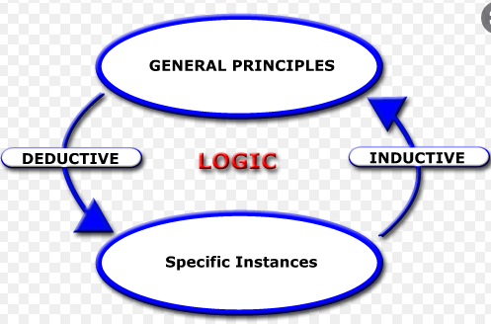
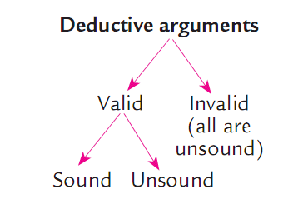
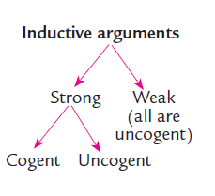
INDUCTIVE REASONING
Review of Chapter 3
DEDUCTIVE REASONING
1. Hypothetical syllogism (if)
2. Categorical syllogism (quantifiers)
3. Argument from definition
4. Argument from elimination
5. Argument based on mathematics
1. Inductive generalization
2. Predictive argument
3. Argument from authority
4. Causal argument
5. Statistical argument
6. Argument from analogy
Notes:
SYLLOGISM: TAM (THREE) ĐOẠN (LINE) LUẬN (REASONING): TWO PREMISES + CONCLUSION

Slide 8
Chapter 9: Categorical Logic
1. Four categorical propositions
2. Translating stylistic variants into standard categorical forms
3. Testing validity using Venn diagram

Slide 9
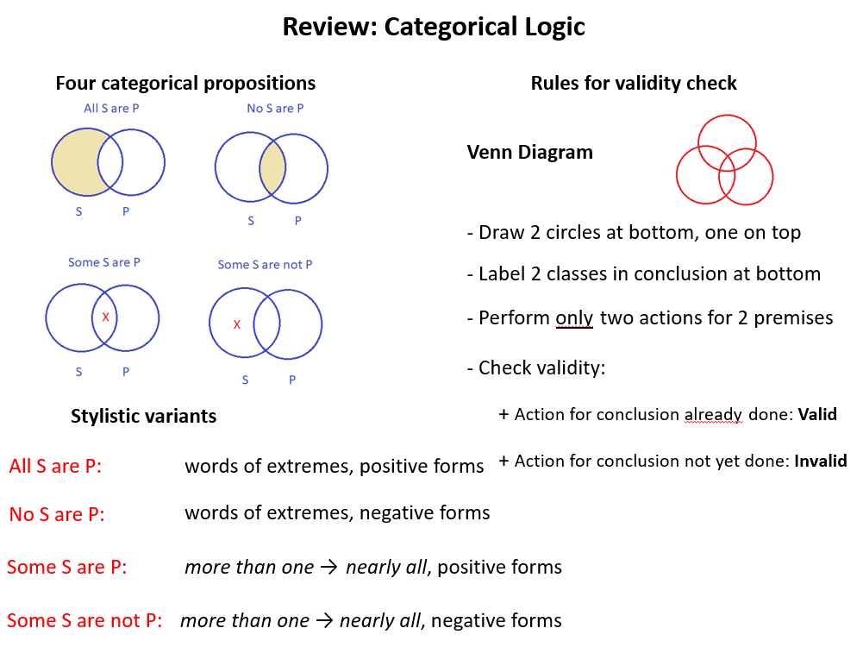


Slide 10
Chapter 10. Propositional logic
1. Conjunction
2. Negation
3. Disjunction
4. Conditional statements
5. Testing validity using the truth table

Slide 11
Review: Propositional logic
1. Propositions/arguments with 2 variables: a true table of 4 lines
2. Propositions/arguments with 3 variables: a true table of 8 lines
3. For propositions, only set up the truth table.
4. For arguments, check validity:
look for the lines where all premise values are true, then look for the conclusion values
If all conclusion values are true: valid
If at least one conclusion value is false: invalid
Rules:
If there is one false conclusion value -> stop: invalid
If conclusion values are true till the last line: valid
If there is no line where all premises are true: invalid

Slide 12
Review for Mid-term Exam

Slide 13
MCQ Questions
1. “Vietnam’s football team is much more skilled than Thailand’s.” This is a case of ____ and it is a/an ____.
missing clarity/standard of critical thinking
sociocentrism/barrier to critical thinking
narrow-mindedness/characteristic of a non-critical thinker
warranted assumption/non-statement
2. “Mary seems to like college because of club activities.” This is a/an ____.
explanation
induction
unwarranted assumption
warranted assumption
Notes:
1B, 2C

Slide 14
3. “China and Vietnam always maintain a strong preference for sons, even at the cost of gender selection.” This text is a case of ____.
moral subjectivism
sociocentrism
stereotype
warranted assumption
4. “Let’s have a thorough review to prepare for the mid-term exam.” This is a/an____.
argument
request
proposal
command
Notes:
3C, 4C

Slide 15
5. “Everybody wants love and respect. Hence, we should love and respect others to receive the same from them.” ‘Hence’ is a _________.
premise indicator
conjunction
conclusion indicator
disjunction
6. “Our Critical Thinking textbook includes some basic logic. Chapter 9 is about categorical logic. This text is a(an) _________.
explanation
illustration
deduction
report
Notes:
5C, 6B

Slide 16
7. “According to UNESCO, literacy is a fundamental human right and the foundation for lifelong learning. This organization affirms that because literacy helps people develop their ability to transform lives.” This is a/an_________.
unwarranted assumption
strong argument
report
cultural subjectivism
8. Mary: Jack told me that his puppy has just given birth to 3 babies!
Melissa: Are you kidding me? How can a puppy have babies?
What Melissa says is ________.
an inductive argument
a deductive argument
a non-argument
two questions
Notes:
7C, 8B

Slide 17
9. Mother: “Peter, you played computer games yesterday. You’re playing computer games now. You’re obviously a game addict!” This is a/an_____.
inductive argument
deductive argument
precise explanation
accurate illustration
10. “Susan has a phobia of height. So she never looks down from top of a high building.”
What is the best major premise for this argument?
Some people never look down from top of a high building.
Susan is one of the people who have a phobia of height.
All people with a phobia of height never look down from top of a high building.
People who never look down from top of a high building may have a phobia of height.
Notes:
9A, 10C

Slide 18
11. “Rome is in Italy. If Rome is in Italy, then Rome is in Europe. So, Rome is in Europe.” This argument is a case of ______ and it is ______.
affirming the antecedent/valid
denying the consequent/invalid
affirming the consequent/invalid
chain argument/valid
12. “No CEOs in our company are Vietnamese so far. This year, the two candidates for this highest leadership are German and Italian. Therefore, our company will always be managed by foreigners.” This argument is a/an_________.
valid deductive argument by elimination
invalid deductive categorical argument
strong inductive argument from analogy
weak inductive predictive argument
Notes:
11 A, 12D

Slide 19
13. “The saying Like father, like son is true in many cases. Bob’s father is a very kind man. So, it is reasonable to assume that _________. Which of the following makes the strongest conclusion?
Bob is not like his father
Bob is a very kind man
Bob always likes his father
Bob is probably kind
14. “Cigarettes are banned in many public places because they harm people’s health. So, mobile phones must also be banned because their radiation harms users’ health.”
This argument is a/an ______ argument and it can be evaluated as ______.
inductive/strong or weak
deductive/ valid or invalid
inductive /sound or unsound
deductive / cogent or uncogent
Notes:
13D, 14A

Slide 20
15. “Taking a person’s life is always wrong. Capital punishment involves taking a person’s life. Therefore, capital punishment is always wrong.” This text is a/an_________.
hypothetical syllogism
sound deductive argument
argument from authority
valid deductive argument
16a. “Six in ten children who are allowed to drink beer and alcohol at home with their parents become alcoholics later in life. Therefore, young people’s drinking habit is formed by their relatives.” This text is a/an________.
inductive argument from analogy
inductive generalization
inductive predictive argument
inductive argument from authority
Notes:
15D, 16B

Slide 21
16b. “A recent survey reports that six in ten children who are allowed to drink at home with their parents become alcoholics later in life. Based on this data, the researcher concludes young people’s drinking habit is formed by their relatives. This survey does wake me up: I’ll never share any drink with my children whatsoever.”
This text is a/an________.
inductive argument from analogy
inductive generalization
inductive predictive argument
inductive argument from authority
Notes:
16b D

Slide 22
17. “If you like fast food, you like hamburgers. So you don’t like fast food because you don’t like hamburgers.”
This argument is a case of _________.
affirming the consequent
denying the consequent
denying the antecedent
affirming the antecedent
18. “I have chosen three items at one dollar each so far. Therefore, this store is certainly a one-dollar store.”
This text is a/an _________.
valid deductive argument
valid inductive argument
invalid inductive argument
weak inductive argument
Notes:
17B, 18D

Slide 23
19. “If the weather is fine, we’ll go on a picnic together. The weather does not have any sign of improvement. Therefore, we won’t go on a picnic.” This is a/an_________.
deductive hypothetical syllogism
deductive argument by elimination
inductive causal argument
inductive predictive argument
20. ‘Last year Airlines X had fewer flights than Airlines Y due to Airlines Y’s cheaper air tickets. With more budget airlines having come into operation, Airlines X must have claimed a loss at the beginning of this year.’ This text is a _________.
deductive hypothetical syllogism
inductive causal argument
inductive predictive argument
deductive categorical argument
Notes:
19A, 20B

Slide 24
21. The symbolic form of the statement “It’s not the case that you don’t go to school but you can study in the classroom.” is ________.
A & ˜B
˜(A v ˜B)
˜(˜ A& B)
(˜A v ˜B)
22. The argument “All celestial stars are famous persons. Venus is a celestial star. So, Venus is a famous person.” is ________.
valid but unsound
invalid and weak
strong but uncogent
strong and cogent
Notes:
21C, 22A

Slide 25
23. “______ Therefore, History was probably NOT a favorite subject of this high school’s students.”
Which of the following is the best premise to make the argument a strong induction?
90% student at a high school chose History for their school leaving exam.
0% student at a high school chose History for their school leaving exam last year.
Nearly 100% students at a high school chose History for their school leaving exam last year.
All students at a high school chose History for their school leaving exam last year.
Notes:
23B

Slide 26
24. “A: Facebook is nothing but a waste of time! More and more people, especially teenagers, spend hours and hours posting and reading nonsense stuff on Facebook.
B: Well, I don’t know if I should agree with you. By the way, have you finished your Critical Thinking group assignment?
A: Yeah, thank God we finished it before the deadline. Our team created a Facebook group, then we connected to divide the workload and we did the assignment quite effectively.”
A’s conclusion lacks ________.
fairness
precision
consistency
accuracy
25. “If the storm comes, we’ll go to the shelter and we won’t let the windows open.”
Select the best option for the given proposition.
The symbolic form of that statement is: A → ˜B v ˜C
We can check the validity by using a truth table with eight lines.
We can general a truth table for three variables.
The text includes a disjunction and a conditional statement.
Notes:
24C, 25C

Slide 27
Categorical logic
Put the given categorical argument into the standard forms, then use Venn diagram to test its validity.
Step 1. Standard form
Step 2. Symbolic argument form
Step 3. Venn diagram
Step 4. Conclusion

Slide 28
A. Put the following categorical argument into the standard form, then use Venn diagram to test its validity.
A. Every CT student this semester is a serious learner.
Not a single serious learner ignore the lessons.
So, all CT students do not ignore the lessons.
B. Most successful people work hard.
There are students who are not are hard-working.
So, at least a student is not successful.

Slide 29
Propositional logic
Put the given argument in the symbolic argument form and determine their validity using the truth table.
Step 1. Standard form
Step 2. Symbolic argument form
Step 3. Truth table
Step 4. Conclusion
Notes:
Tricks to remember values of all propositions:
Conjunction: ONLY two T values: True
Negation: ~(compound proposition)
Disjunction: ONLY one T value: True
Conditional statement:
- same values for antecedent and consequent: True
- different values for antecedent and consequent: get the value of the consequent

Slide 30
Propositional logic
It’s not the case that IU is an international university and IU students are not qualified. So, IU is an international university because IU students are qualified.
You will not understand the lesson as you always wake up late. If you don’t wake up early, you will miss the first period with the important contents of the lesson.
If buses are in better condition or the wait time is shorter, students will travel to school by bus. Students will not travel to school by bus, because it’s not the case that these means of transport are improved and the wait time is shorter.

Slide 31

7 pm- midnight – June 1
QUIZ 2

